Slide 1
Database system
Saba Ghani
FAST-NU
Chiniot Faisalabad Campus

Slide 2
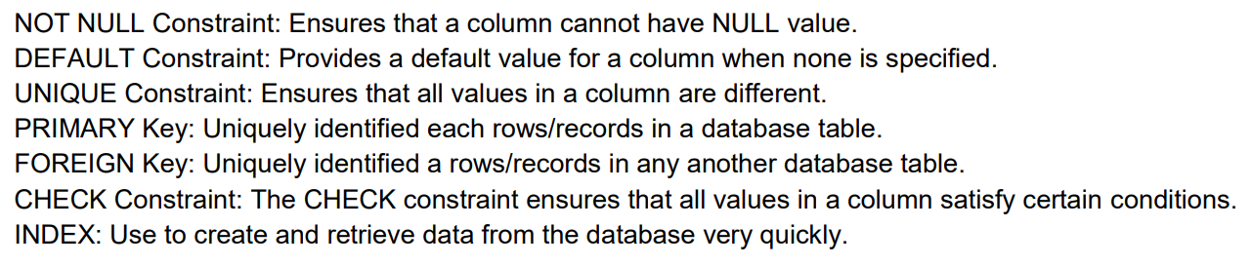
SQL Constraints
Constraints are the rules enforced on data columns on table. These are used to limit the type of data that can go into a table. This ensures the accuracy and reliability of the data in the database.

Slide 3
FK Constraints
Syntax
Foreign key(attribute(s) Name) References Table_Name (Attribute(s))
DEP(Dnum,Name)
EMP(Id, Name, Dno) *to be created
Create table EMP
(
id int Primary key,
Name Char(10) not null,
Dno int,
Foreign key (Dno) References DEP(Dnum)
);

Slide 4
FK Constraint
Referential triggered action
The default action that SQL takes for an integrity violation is to reject the update operation that will cause a violation.
However, the schema designer can specify an alternative action to be taken by attaching a referential triggered action clause to any foreign key constraint.
The options include SET NULL, CASCADE, and SET DEFAULT.
An option must be qualified with either ON DELETE or ON UPDATE.

Slide 5
CREATE TABLE supplier (
supplier_id numeric(10) not null,
supplier_name varchar(50) not null,
contact_name varchar(50),
PRIMARY KEY (supplier_id, supplier_name)
);
CREATE TABLE products (
product_id numeric(10) not null,
supplier_id numeric(10) not null,
supplier_name varchar2(50) not null,
PRIMARY KEY(product_id),
FOREIGN KEY (supplier_id, supplier_name) REFERENCES supplier(supplier_id, supplier_name)
ON DELETE CASCADE
); The cascade delete on the foreign key causes all corresponding records in the products table to be cascade deleted when a record in the supplier table is deleted, based on supplier_id and supplier_name.

Slide 6

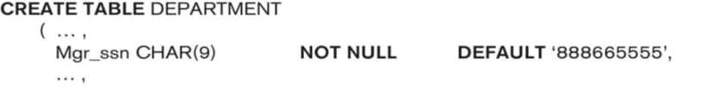

Slide 7
DROP DDL Commands
Drop commands delete specific Table, Index or Database, views.
The SQL DROP TABLE statement is used to remove a table definition and all data, indexes, constraints, and permission specifications for that table.
Syntax
DROP TABLE table_name;
DROP VIEW view_name;
DROP TABLE CUSTOMERS;

Slide 8
ALTER Commands
The ALTER TABLE statement is used to add, drop, or modify columns in an existing table.
Drop
Add
Modify
SQL ALTER TABLE Syntax
To add a column in a table, use the following syntax: ALTER TABLE table_name ADD column_name datatype;
To delete a column in a table, use the following syntax (notice that some database systems don't allow deleting a column):
ALTER TABLE table_name DROP COLUMN column_name;
Alter table STD
Add contact_no int no null;
Alter table STD
Drop COLUMN Hobby;

Slide 9
ALTER Commands
To change the data type of a column in a table, use the following syntax:
ALTER TABLE table_name MODIFY column_name datatype;
ALTER TABLE CUSTOMER
ADD PRIMARY KEY (ID);
Alter table STD
Modify Name char not null;
Notes:
ASSERTION AND TRRIGER OPEL 119

Slide 10
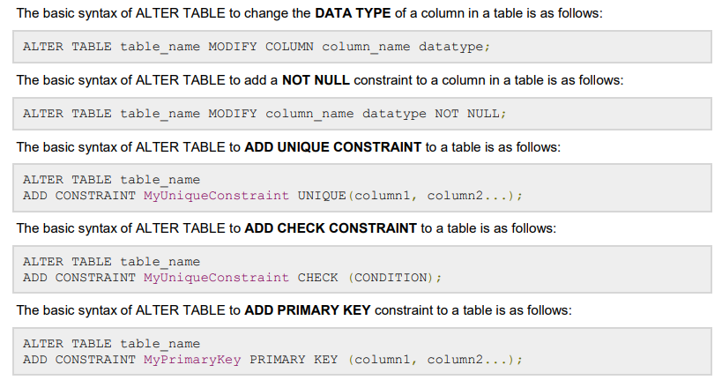



Slide 11
Class Task
EMPLOYEE
SSN int | Name char | Address char | Salary int | SuperSSN int | Dno int | No-of-child
Add column Designation and DOB in Employee table
Change data type of address to varchar
Drop column No_of_child
Drop table
Notes:
ASSERTION AND TRRIGER OPEL 119

